Slide 1
How to Access the SF Employee Learning Portal
A Quick Guide for UCSF Faculty, Staff, and Trainees at ZSFG
Reminders | Use Firefox, Microsoft Edge, or Chrome Turn Off Pop-Up Blockers

Slide 2
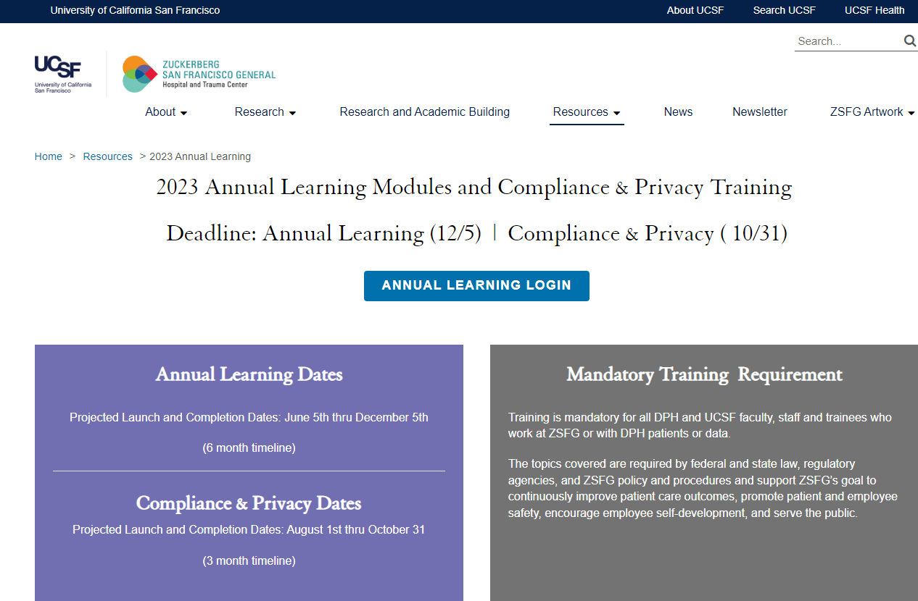
Step 1
Visit: https://zsfg.ucsf.edu/sflearn
Select Link

Slide 3
Step 2
CCSF Login Page
If you know your POI# and Password, skip to Step 6
Enter UCSF POI#
Contact: Department Manager/ Champion or Trainee Administrator for Assistance
Enter Password
First Time User?
Contact DPH IT for temporary password, 628-206-7378
Previous User and Forgot Password?
Select ‘Forgot your password?’ link
Select ‘Agree & Sign In’
IF you entered both POI# and Password

Slide 4
Step 3
Forgot your password? Page
Enter your UCSF POI#
Select ‘Submit’

Slide 5
Step 4
Verifying Secure Code Page
Enter Secure Code from Phone
Select ‘Verify’

Slide 6
Step 5
Reset Password Page
New Password Guidelines:
10 characters
One numeric character
One uppercase character
One lowercase character
One special character
New & confirm password must match
Select “Submit’

Slide 7
Step 6
CCSF Login Page
Enter UCSF POI#
Enter Password
Select ‘Agree & Sign In’

Slide 8
Step 7
Verifying Secure Code
Enter Secure Code from Phone
Select ‘Trust this device for 30 days’
Select ‘Verify’

Slide 9
Step 8
CCSF Dashboard Page
If you have logged onto this site previously, you may be directed to Step 12
Select ‘Multi-Factor’
(To Add Additional Layer of Security)

Slide 10
Step 9
Multi-Factor Page
Please configure any 2 out of the 3 options
(i.e. Mobile App, Mobile Number, or Security Questions)
Multi-Factor adds an additional layer of security to your account by using your mobile app, Mobile number, non-City email or security questions to verify your identity. Once set up, other Users cannot access your account even if they guess your password. If you need to reset your Password, you can use Multi-Factor options to verify your identity.

Slide 11
Step 10
CCSF Dashboard Page
Choose ‘SF Employee Portal’

Slide 12
Step 11
SF Employee Portal
DO NOT Select ‘My Learning’ option
Select ‘Work Links’
then

Slide 13
Step 12
SF Learning Platform Page
Select ‘My Learning’

Slide 14
Step 13
#2
My Learning Requirements Portal: Current
#1
Arrows #1, #2, and #3: Ensures you are in the ‘Current’ Tab of the ‘My Learning’ section to view all required trainings and to select ‘Launch’ to start a training.
#3
Select the title of the module to start a requirement. Do NOT select 'Launch'

Slide 15
Step 14
Recommended: Take Screenshots
Helpful Tip:
Take screenshots when completing a module & requirement, in case the system does not automatically record completion.

Slide 16
Step 15
My Learning Requirements Portal: History
#1
#3
#2
Arrows #1, #2, and #3: Ensures you are in the ‘History’ Tab of the ‘My Learning’ section to verity the system recognizes completion of the Cybersecurity Training.

Slide 17
Congratulations!
You have successfully logged into the SF Employee Portal, launched the My Learning application, and completed the Annual Cybersecurity training!

Slide 18
THANK YOU!

